Slide 1
DD Waiver Online Claim Entry CMS-1500
Conduent
Government Healthcare Solutions

Slide 2
Resources
When online use: Ask Service Representative
HIPAA.Desk.NM@Conduent.com
NMProviderSupport@Conduent.com
Call Center 505-246-0710 or 800-299-7304
New Mexico Web Portal
Provider Information section
Links and FAQ section
Provider Login section

Slide 3
Topics of this Workshop - Webinar
When online use: Ask Service Representative
HIPAA.Desk.NM@Conduent.com
NMProviderSupport@Conduent.com
Call Center 505-246-0710 or 800-299-7304
New Mexico Web Portal
Provider Information section
Links and FAQ section
Provider Login section

Slide 4
Important State Websites
STATE WEBSITE:
PROGRAM POLICY MANUAL
http://www.hsd.state.nm.us/mad/policymanual.html
BILLING INSTRUCTIONS
http://www.hsd.state.nm.us/mad/billinginstructions.html
REGISTERS AND SUPPLEMENTS:
http://www.hsd.state.nm.us/mad/registers/2012.html

Slide 5
Claim Form Instructions
Conduent
Government Healthcare Solutions

Slide 6
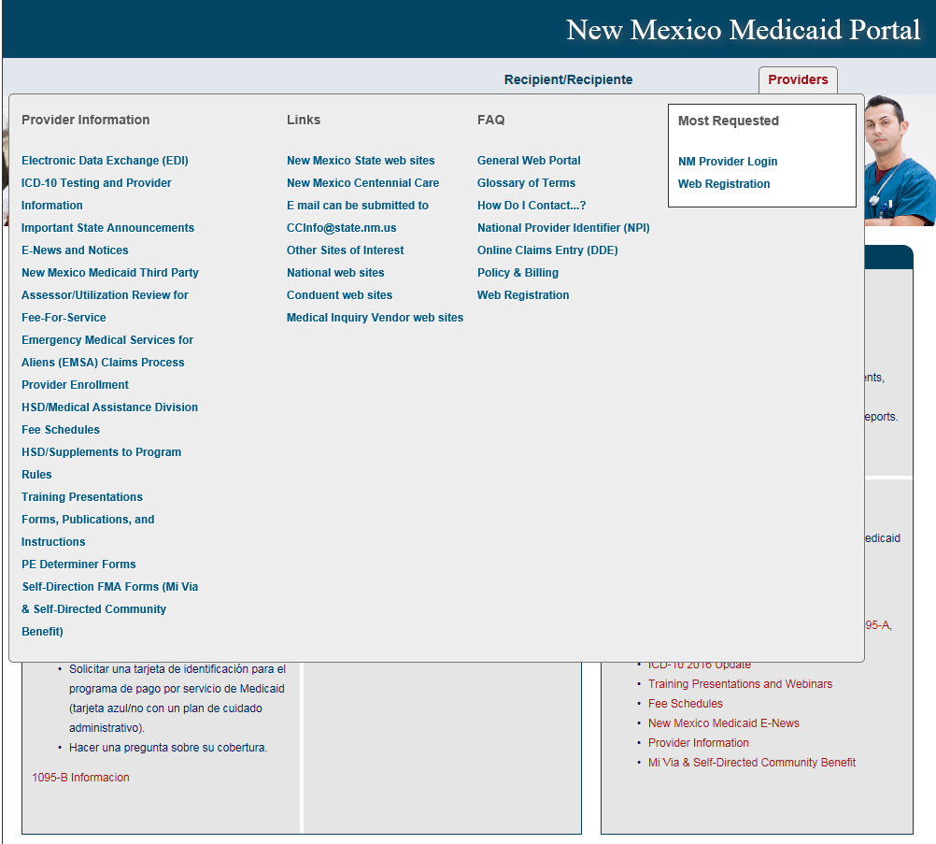
Where Do I Get a Copy of Claim Form Instructions?
On the WEB PORTAL: Click Providers then Forms, Publications, and Instructions under Provider Information
Continued on next screen…

Slide 7
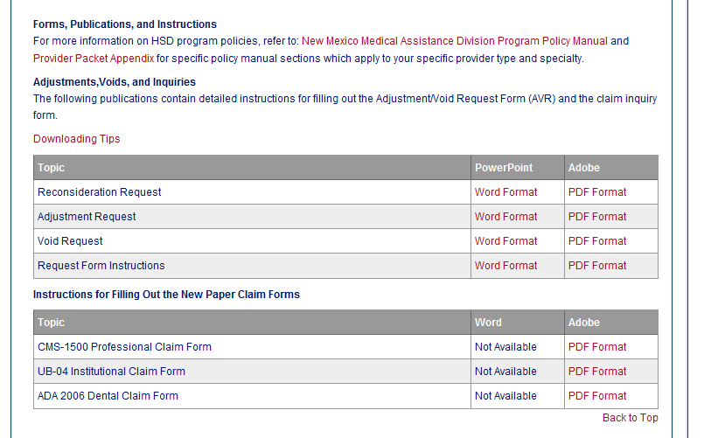
Where Do I Get a Copy of Claim Form Instructions?
Scroll down
Open file
Notes:
Make titles consistent – capital letters

Slide 8
Timely Filing
Conduent
Government Healthcare Solutions

Slide 9
What is a Transaction Control Number (TCN)?
91604900085000001
The twelfth digit in an adjustment/ void TCN will either be:
1= Debit
2= Credit
The first digit indicates what the claim “media” is:
2 = electronic crossover
3 = other electronic claim
4 = system generated claim or adjustment
8 = paper claim
9 = Web portal claim entry
Batch number
The last two digits of the year the claim was received
The numeric day of the year.
The claim number within the batch.
This is the Julian Date - this represents the date the claim was received by Conduent: this claim was received the 49th day of 2016, or February 18, 2016
Notes:
Global slide – indicate somehow

Slide 10
Timely Filing Denials
Re-filing Claims and Submitting Adjustments
Important Note: Remittance Advices are not considered proof of timely filing.
Notes:
Important Note: Remittance Advices are not considered proof of timely filing.

Slide 11
National Corrective Coding Initiative (NCCI)
Conduent
Government Healthcare Solutions

Slide 12
NCCI
A CMS program that consists of coding policies and edits. Medicaid NCCI Edits consist of two types:
NCCI procedure-to-procedure edits that define pairs of Healthcare Common Procedure Coding System (HCPCS)/Current Procedural Terminology (CPT) codes that should not be reported together for a variety of reasons
Medically Unlikely Edits (MUE), units-of-service edits, that define for each HCPCS/CPT code the number of units of service beyond which the reported number of units of service is unlikely to be correct (e.g., claims for excision of more than one gallbladder or more than one pancreas).

Slide 13
NCCI
Remittance Advice (RA)/Explanation of Benefits (EOB) Codes:
6501 or 6502 - Per the National Correct Coding Initiative, payment is denied because the service is not payable with another service on the same date of service.
6503 through 6505 - Per the National Correct Coding Initiative, payment is denied because provider billed units of service exceeding limit.
Please visit the Medicaid.gov webpage for the NCCI in Medicaid:
The National Correct Coding Initiative in Medicaid

Slide 14
Add/Manage Templates
Conduent
Government Healthcare Solutions

Slide 15
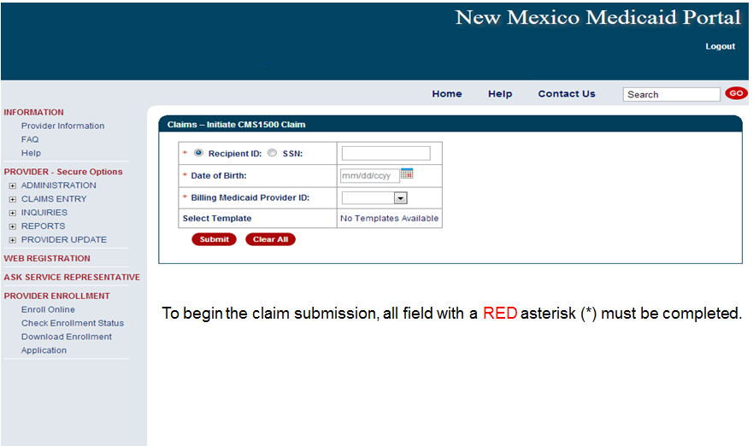
Online Claims Entry

Slide 16
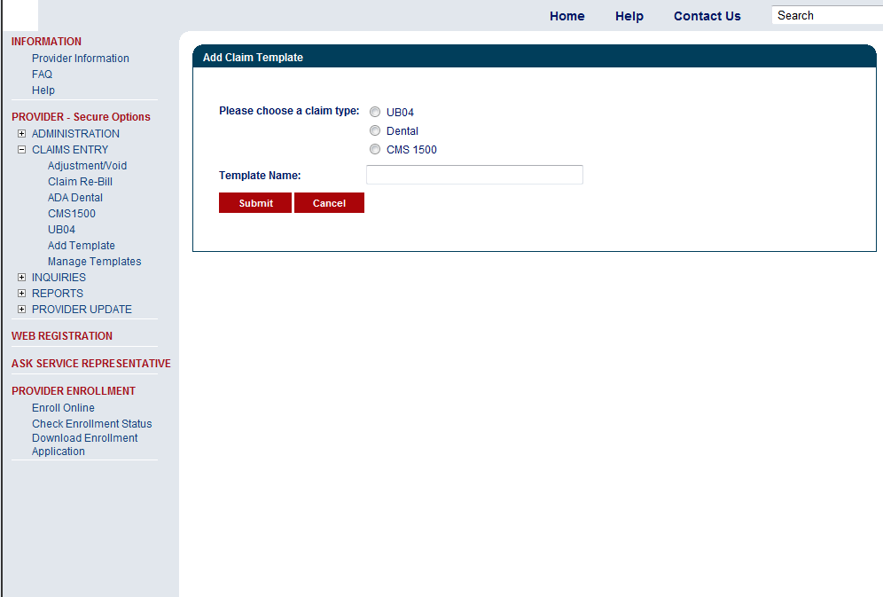
CMS 1500 – Create a Claim Template
Create Name
for template

Slide 17
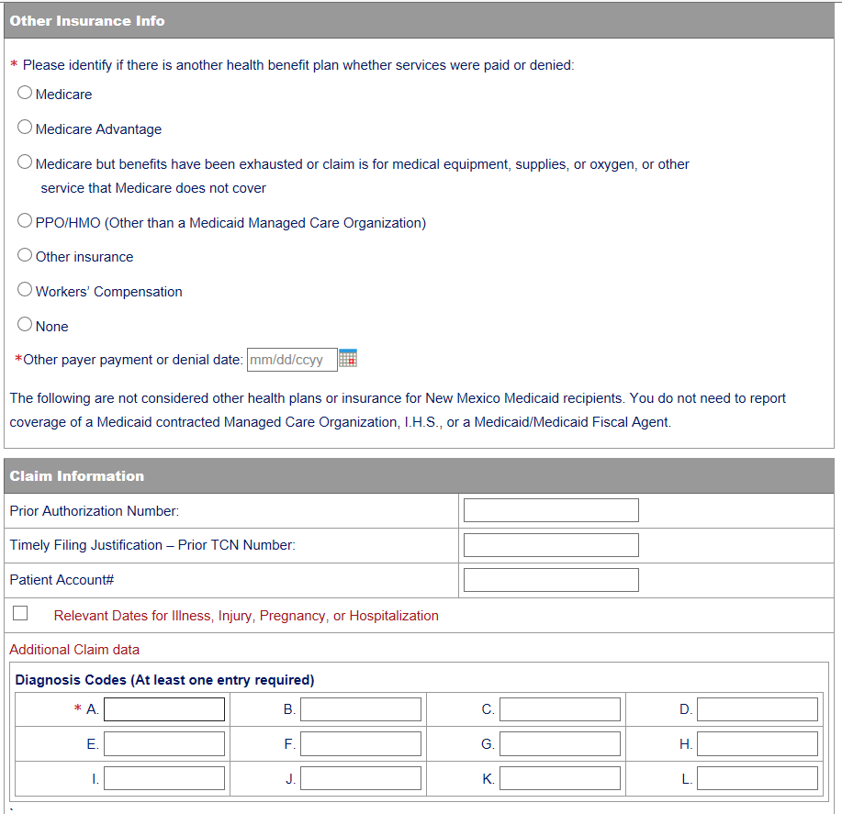
CMS 1500 - Add Claim Template
Fill out any information you would like included in your template

Slide 18
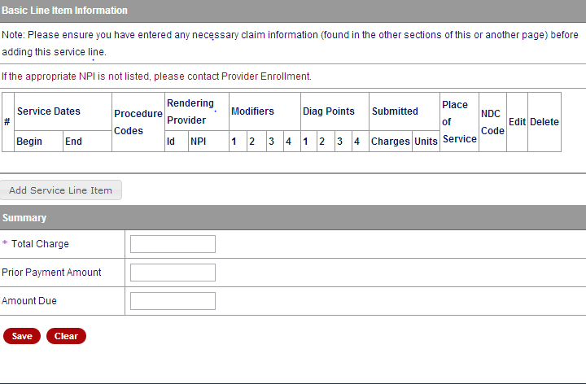
CMS 1500 - Add Claim Template
Fill out any information you would like included in your template
Notes:
The fields with Red Asterisks (*) are REQIRED

Slide 19
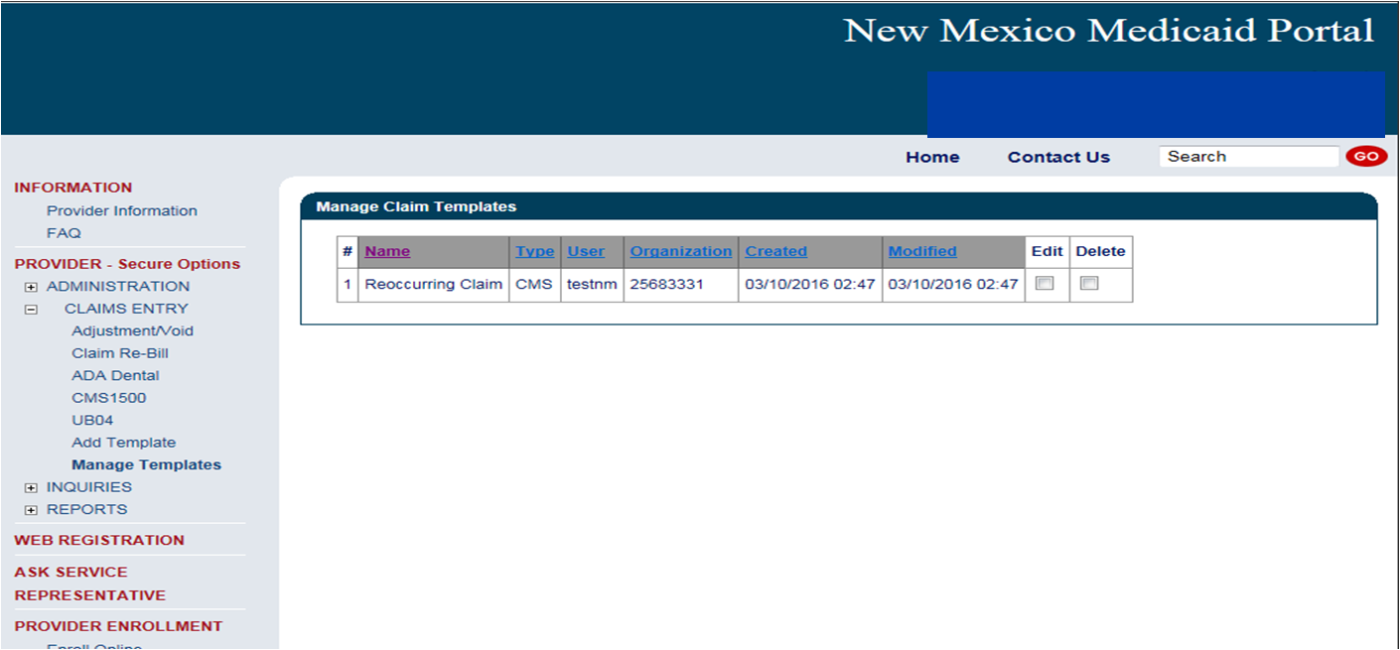
CMS 1500 Manage Templates
Here is where you Edit and/or Delete any information on your claim template

Slide 20
Medicaid Primary Claim Forms
Conduent
Government Healthcare Solutions

Slide 21
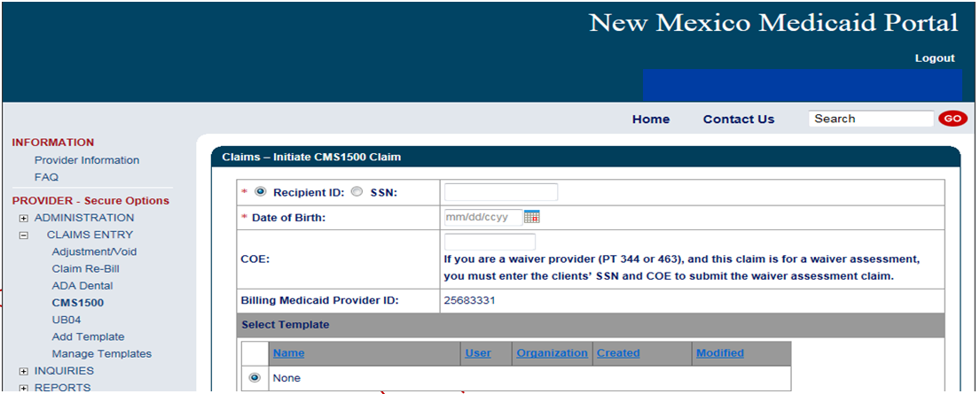
Online Claims Entry
Fields with Red asterisks (*) are required information

Slide 22
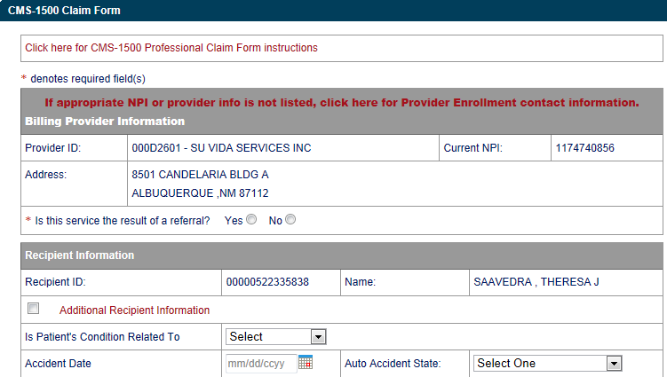
Online Claims Entry Primary Claim Continued
Click on the RED text for the CMS 1500 Claim form instructions

Slide 23
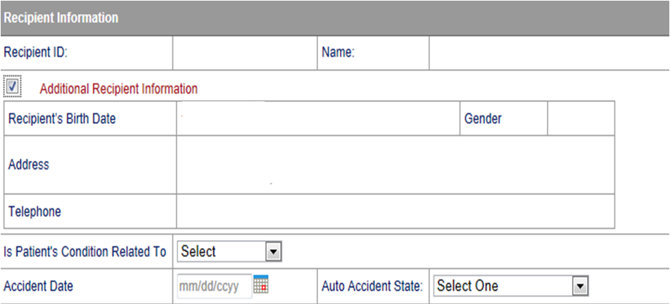
Additional Recipient Information Option
Sections can be expanded by selecting all sections with Red Text
Select “Additional Recipient Information” if Patient Condition information is needed to process claim.

Slide 24
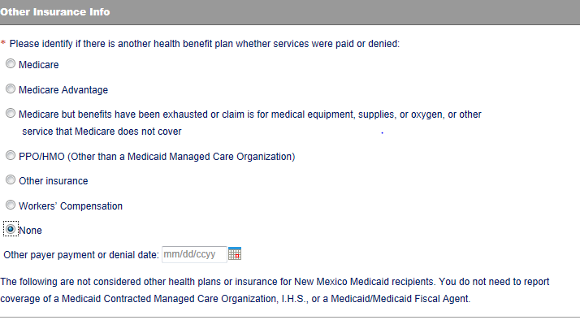
Medicaid Primary Claim Forms
If none – Click none

Slide 25
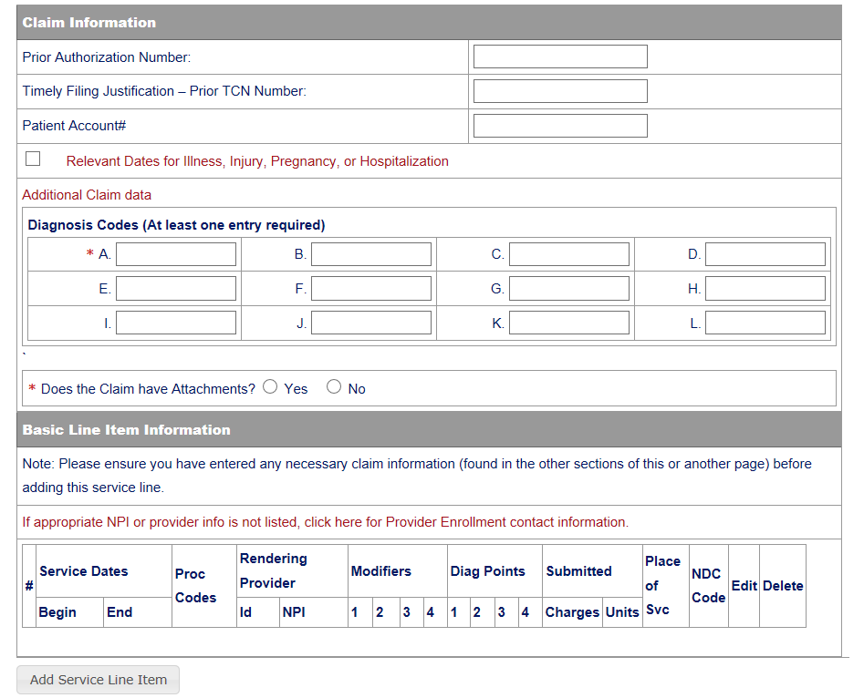
Claims Information
Section Can be Expanded by Clicking here

Slide 26
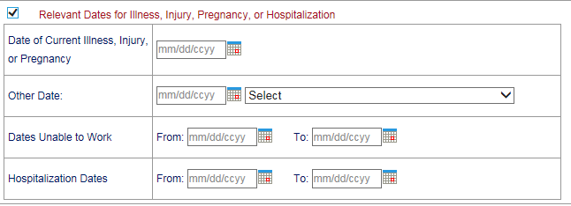
Claims Information – Relevant Dates
Expanded “Relevant Dates” Section

Slide 27
Claims Information – Attachments

Slide 28
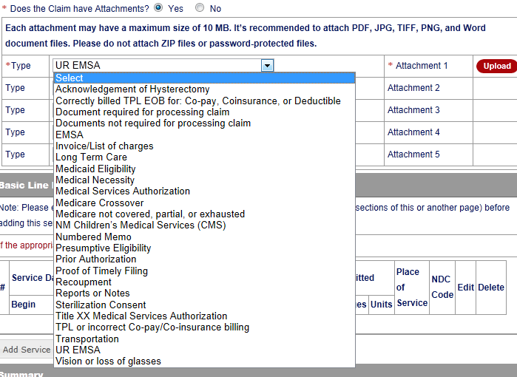
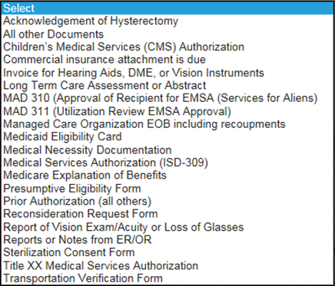
Claims Information – Attachments
Attach a copy of the EOB along with the explanation of denials page

Slide 29
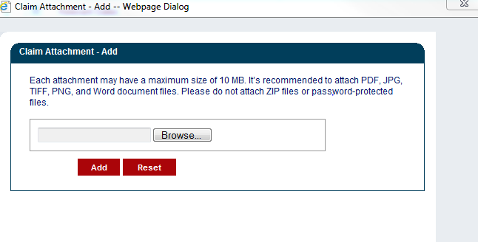
Claims Information – Attachment Upload
Review the Uploading Attachments Restrictions.
You can attach files up to 10 MB in size
Do not upload ZIP Files, Excel Spreadsheets or Password Protected Files. PDF, JPG, TIFF, and Word Documents files are recommended

Slide 30
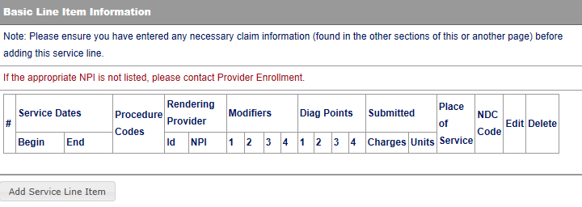
Line Item Information
Click to add Line Items

Slide 31
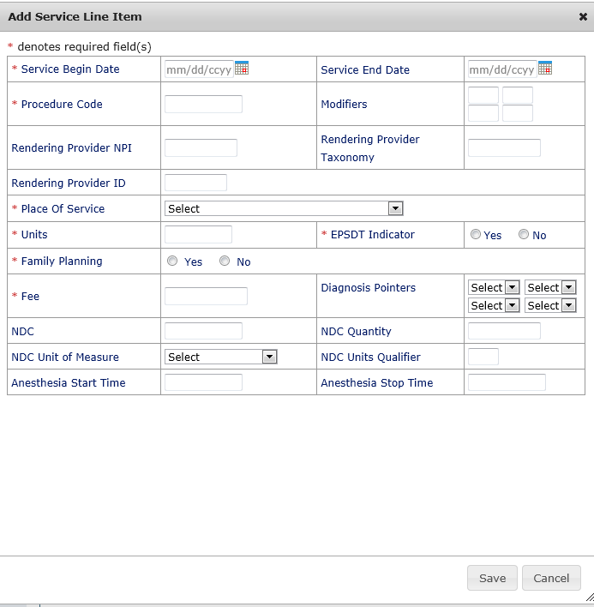
Adding Additional Line Item Information
The fields with Red Asterisks (*) are REQUIRED

Slide 32
Medicaid Primary Claim Forms
Identify if there is another health benefit plan service that either paid or denied

Slide 33
What questions do you have?
If you have question or need support you can:
Email:
NMPoviderSupport@Conduent.com (General Questions)
HIPAA.Desk.NM@Conduent.com (HIPPA Specific)
Call 505-246-0710 or 800-299-7304 - to directly reach all provider help desks including Provider Relations, Provider Enrollment, the HIPAA/EMC help desk and TPL

Slide 34
Thank you
Special thanks to the community members for feedback and the development of this training session. Brenda Johnson, Laurie Brennen, Lourie Pohl, Robert Hobbs, Nancy Searcy.
It is only with your feedback we can continue to improve, please feel free to e-mail NMPoviderSupport@Conduent.com with your feedback, comments and suggestions.

Slide 35
Resources
When online use: Ask Service Representative
HIPAA.Desk.NM@Conduent.com
NMProviderSupport@Conduent.com
Call Center 505-246-0710 or 800-299-7304
New Mexico Web Portal
Provider Information section
Links and FAQ section
Provider Login section

